Slide 1
Introduction to Software Development Methodologies Part 1: Examples
Phil Pfeiffer
Fall, 2014

Slide 2
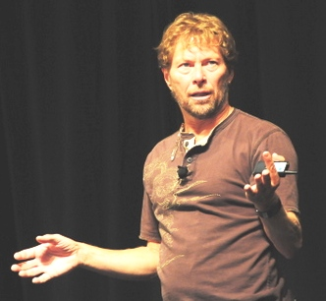
Methodology Defined
Everything you
regularly do to get
your software out.
-- Alistair Cockburn
The [social] conventions
your group agrees to
[to produce work].
-- Alistair Cockburn
Implies coordinating people's activities on a team; cooperation; and communication.
Source: Cockburn, Agile Software Development

Slide 3
Rationale for Standardizing Methodology
Ensure development strategies address
key threat(s) to project success
Delineate responsibilities
Introduce new people to organizational processes
Create basis for educating people in processes
Allow an organization to substitute for people
Impress project's sponsors with an organization's competence
Create basis for assuring sponsors that progess is being made
Source (points 2-7): Cockburn, Agile Software Development

Slide 4
Problem w. Cataloguing Methodologies
Thousands
No standard taxonomies
Surveys only focus on specific types:
e.g., structured, object-oriented, SOAs

Slide 5
One Division: Big-M vs. Little-M
Little-M Methodologies
▪ define how to do a [specific] job
▪ some deliverables with their standards
▪ perhaps a few techniques
▪ typically focus on one phase of software lifecycle
Big-M Methodologies
▪ comprehensive process for producing systems
▪ often assembled from little-M methdologies
Sources: http://alistair.cockburn.us/Methodology+space; Peopleware (DeMarco and Lister)

Slide 6
Little-M Methodologies: Examples
Requirements oriented methodologies
▪ Joint Application Development (JAD)
▪ Prototyping
Design and analysis methodologies
▪ Nassi-Shneiderman diagrams
▪ Jackson Structured Programming (JSP)
▪ Structured design
▪ Structured analysis
▪ Object-oriented design
▪ Object-oriented analysis
Coding and Testing Methodologies
▪ Test-Driven Design (TDD)
▪ Behavior-Driven Design (BDD)
▪ Feature-Driven Development (FDD)
▪ Scrum
▪ Vertical Slice Testing (VEST)

Slide 7
Little-M: Joint Application Development (JAD)
Workshop-based approach for requirements gathering
▪ Participants: executive sponsor; key stakeholders (business, IS people, experts); facilitator; scribe
▪ Process
▪ Identify project objectives and limitations
▪ Identify critical success factors
▪ Define project deliverables
▪ Define schedule of workshop activities (initial: 3-5 days)
▪ Select participants
▪ Prepare workshop material
▪ Organize workshop activities and exercises
▪ Prepare, inform, educate the workshop participants
▪ Coordinate workshop logistics
Source: http://en.wikipedia.org/wiki/Joint_application_design

Slide 8
Little-M: Prototyping
Multiple, partial versions of software used to elicit requirements
Strategies for using prototypes
▪ Throwaway - discard after developing
▪ typically uses low-overhead, nonfunctional UI mockups
▪ Evolutionary - transform prototype, over time, into product
▪ code-as-you-go
▪ provides imperfect, but possibly useful, functionality over course of project
▪ also provides basis for estimating, scheduling project
▪ Operational - hybrid
▪ use evolutionary prototypes for main development
▪ use throwaways to evolve main prototype
Sources: http://en.wikipedia.org/wiki/Software_prototyping

Slide 9
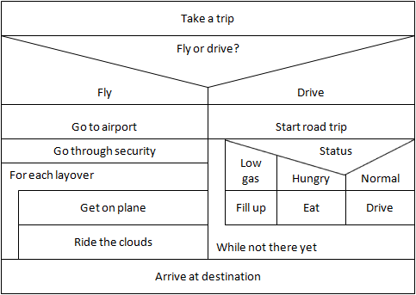
Little-M: Nassi-Shneiderman Diagrams
Developed in 1972 by Isaac Nassi and Ben Shneiderman, graduate students at SUNY-Stonybrook
Standardized in Germany in 1985 as DIN 66261
For depicting structured logic, about as clean as it gets
source: http://en.wikipedia.org/wiki/Nassi%E2%80%93Shneiderman_diagram

Slide 10
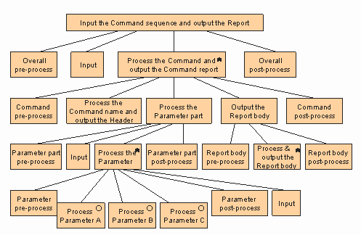
Little-M:
Jackson Structured Programming (JSP)
First described in 1975
by Michael (!) Jackson
Process:
  Generate diagram(s) of input structure(s)
  Generate diagram(s) of output structure(s)
  Link outputs to the inputs from which they're derived
  Generate tree of tasks, using the linkages
    Use *s in upper right hand corners of task boxes to denote repetition
    Use ºs in upper right hand corners of task boxes to denote selection

Slide 11
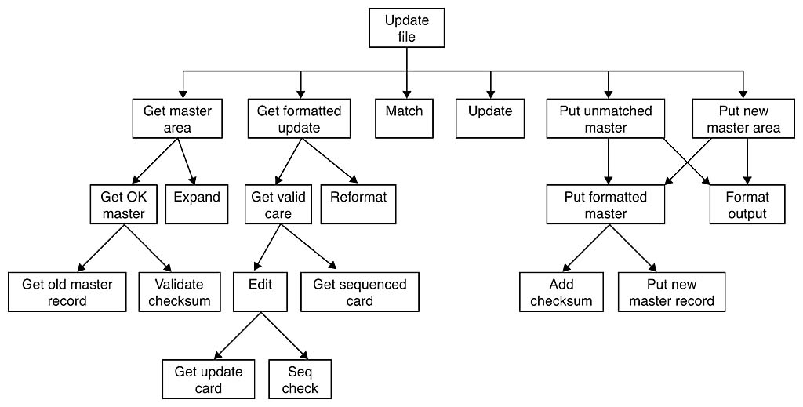
Little-M: Structured Design
One in family of structured methodologies from the 1970s
Authors: Larry Constantine, Ed Yourdon, Wayne Stevens
Focus: procedural
  Depicted a task as a hierarchy of modules
    rooted at a main and
    connected by lines representing caller-callee relationships, with annotations (not shown) to depcit parameters
Key contribution: use of Constantine metrics for cohesion and coupling to assess quality of design

Slide 12
Cohesion (best to worst)
Functional - the task; the whole task; nothing but the task
  Typical: strong verb + specific direct object (e.g., compute square root)
  Optimal cohesion: strive for this everywhere; settle for no less.
Sequential - 1 sequence of subtasks for 1 well-defined task
  Typical: do this to A then that to A … (e.g., open file, then validate format)
  Better: split into separate, functionally cohesive actions
Communicational - 1 set of subtasks for 1 well-defined task
  Typical: do this to A and that to A … (e.g., check gen-ed and major grad. req's.)
  Better: split into separate, functionally cohesive actions
Procedural - 1 sequence of subtasks across 2 or more consecutive tasks
  Typical: do this to A then that to B … (e.g., print and close this file, open the next)
  Redesign, based on constituent objects
Temporal - 1 set of 2 or more concurrent tasks
  Typical: do this to A, B, C … (e.g., print grad. notice, diploma, and alumni message)
  Redesign, based on constituent objects
Logical - grouping of multiple, superficially related tasks
  Typical: specific action on one of K flag-selected objects (e.g., validate thing)
  Often a bad attempt to reuse buffers and/or code snippets. Redesign around objects.
Coincidental - grouping of multiple, unrelated tasks
  Typical: totally vague name (e.g., do stuff; do misc. stuff) with flags
  Atrocious; often a consequence of ill-considered code enhancements. Redesign.

Slide 13
Coupling through a function's iterface (better to poorer)
Null - no shared data
  Best, when practical – but contrast 1 "set(r,g,b)" with 2**24 "set color()" routines!
Data - sharing of individual items
  Sharing of individual datums only, with all sharing on a strictly "need to know" basis
  Commonly, the best one can do
Stamp - sharing of multi-item datasets, including items the function won't use
  Examples: employee records; chessboards
  Often reasonable, but could obscure analysis of what function does, doesn't access;
Control - sharing of parameters that direct behavior
  Examples: flag/switch inputs; status returns that ask caller to recover from error
  Avoid: split routines into "set state" and "do task" routines
Coupling external to a function's interface (avoid!)
External - sharing via persistent store: e.g., file, database, device
Common - sharing via a FORTRAN-like common area or equivalent (e.g., namespace)
Global - sharing via global variables
Content – "white box" sharing, including
  Branching into a second function's code
  Referencing or changing a second function's local data
  Dynamically changing a second function's statements
  Sharing of literals (i.e., compile-time constants)
  a.k.a. "premature binding" (http://kkspot.110mb.com/Data/CS/sda/module%202.1%20.ppt#297,20)

Slide 14
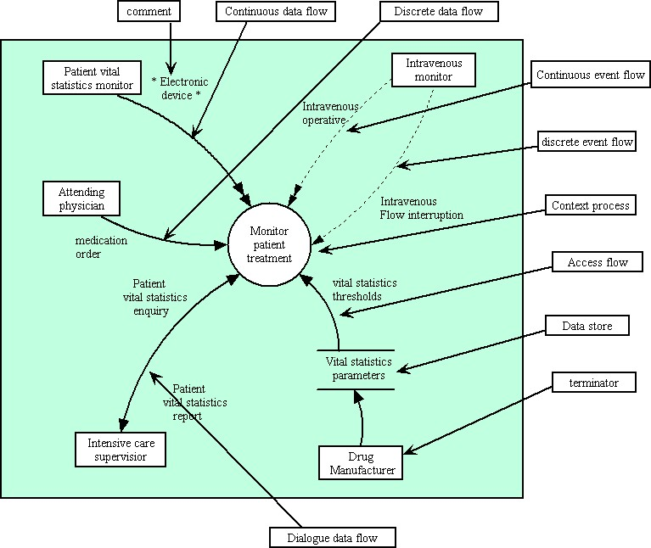
Little-M: Structured Analysis
1970's era follow-on to
structured analysis
Authors: Tom DeMarco, Ed Yourdon, Gane & Sarson, McMenamin & Palmer.
Depicted a domain as a state-diagram-like network of rectangles (sources), bubbles (processes), and capacitors (datasets), linked by arrows (data flows)
Flows represented data; bubbles, incremental transformations on that data
Bubbles could be leveled: i.e., contain other bubbles
Later extended for event-driven programming

Slide 15
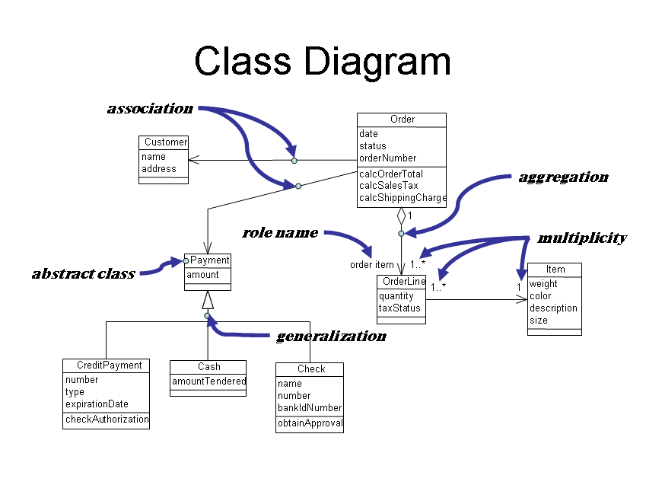
Little-M: Object-Oriented Design
Roots in Simula
programming language
  Authors: Dahl, Nygaard
  (1962-7 (!))
  Developed for system simulation
First practical realization of language: C++
Key ideas
  Model program as "ecosystem" of interacting objects
    object: entity with identity, interface, behavior, state, lifetime
    includes modeling of platform components
  Use classes to specify, generate collections of objects of common type
  Use inheritance to share code between classes of related types

Slide 16
Little-M: Object-Oriented Analysis
Very much like OO Design, but with a focus on customer requirements, rather than objects that address specifics of platforms in use
Primary tasks:
  Identify the domain's objects
  Organize the objects
  Describe how the objects interact
  Define the behavior of the objects
  Define the internals of the objects
source: http://en.wikipedia.org/wiki/Object-oriented_analysis_and_design

Slide 17
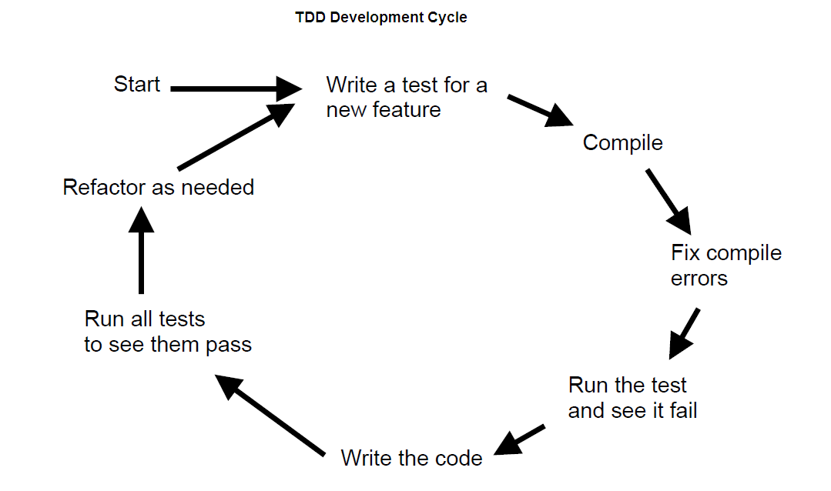
Little-M:
Test-Driven Development (TDD)
Tests drive, document, and certify development
Process
▪ Define requirements for a feature to implement
▪ Define a set of test cases that test feature's requirements
▪ Verify that the tests fail on null feature implementations
▪ Implement the feature
▪ Verify that the implementation passes its tests
Sources: http://en.wikipedia.org/wiki/Test-driven_development

Slide 18
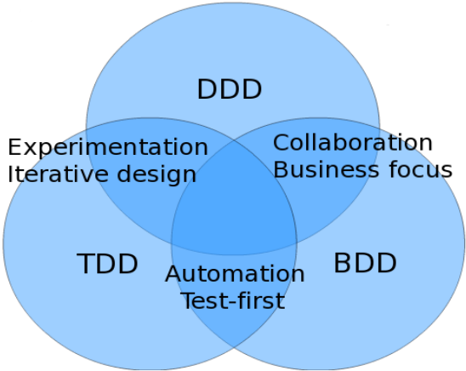
Little-M: Behavior-Driven Development (BDD)
Extension of TDD that
Combines TDD with domain-driven design: i.e.,
  vision of programming as an activity that
  models human models of problem domains
  emphasis on developing common language
  for developer-domain expert communication
Extends testing to system specifications, via human-readable, declarative frameworks for defining such tests (e.g., Cucumber, RSpec): e.g,
Given a 4 by 4 game
When I toggle the cell at (3, 2)
Then the grid should look like
.....
.....
.....
..X..
source: http://en.wikipedia.org/wiki/Behavior-driven_development

Slide 19
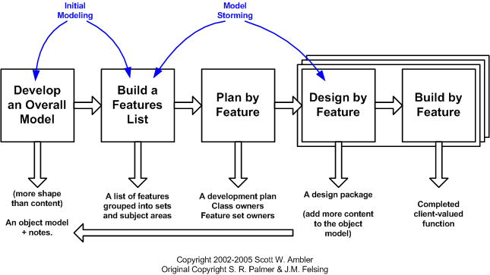
Little-M: Feature-Driven Development (FDD)
Incremental, feature-by-feature product development
Process (for each increment)
▪ Chief architect develops overall model, including class diagram
▪ Chief programmers build a features list
▪ Domain decomposed into activity steps (features) within business activities within subject areas
▪ Granularity: larger than getters and setters, but <2 weeks to implement
▪ Project manager, development manager, chief programmers plan order in which features are implemented
▪ Each chief programmer designs subset of features
▪ Developers develop assigned features
Source: http://www.featuredrivendevelopment.com/files/fddprocessesA4.pdf

Slide 20
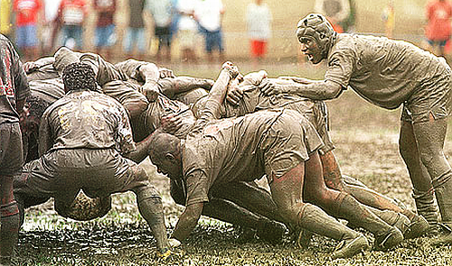
Little-M: Scrum
Focuses on constructing and
delivering software
  presupposes requirements,
  architecture, design
Managed by chief programmer, called scrum master
▪ Input: prioritized list of product features
▪ Process: 3-phrase process, called scrum
▪ Initial: team selects features, plans work
▪ Development: uses fixed-time sprint--often, 2-4 weeks
▪ Daily progress meetings, under scrum master's supervision
▪ Ending: review and retrospective
▪ Output: a potentially shippable deliverable
Repeats until work or budget depleted or deadline arrives
Source: http://www.scrumalliance.org/learn_about_scrum

Slide 21
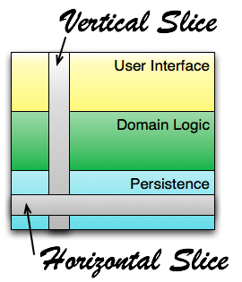
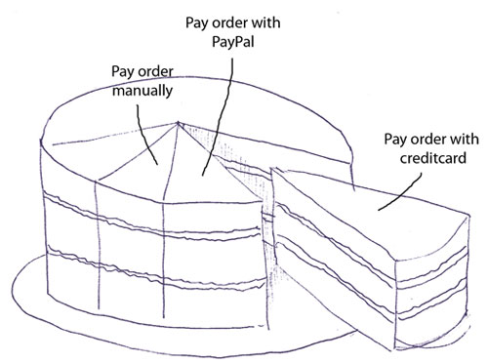
Little-M: Vertical Slice Testing (VEST)
Developing a system by delivering it "in pieces", one block of functionality at a time
Pragmatics
  Requirements for slices, according to Andre Dhondt: INVEST
    Independent, Negotiable, Valuable, Estimable, Small, and Testable
  Disadvantage: hard to conceptualize systems as vertical slices
  Advantage
    Supports immediate focus on parts of system that deliver most value
    Delivers value sooner
sources: http://en.wikipedia.org/wiki/Vertical_slice, http://simpleprogrammer.com/2011/11/21/understanding-the-vertical-slice/, http://dhondtsayitsagile.blogspot.com/2012/10/the-keystone-habit-thin-vertical-slices.html

Slide 22
Big-M: a Categorization
Linear: e.g., waterfall, Jackson system development, V-model, W-model
Iterative: e.g., iterative and incremental, spiral, RUP, XP, MSF, DSDM, VEST
Component-Based: e.g., Y-model
Software Product Line: e.g., COPA, FAST
Transformational: e.g., Cleanroom, formal methods
Sources: largely from
Osama Eljabiri, http://eljabiri1.tripod.com/sitebuildercontent/sitebuilderfiles/Software-Development-Strategies.pdf

Slide 23
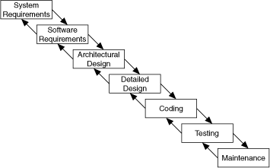
Big-M: Waterfall
First description: 1956 paper
by Herbert Bennington (though deviation
from lock-step staging noted in paper)
First formalization as model: 1970 paper by Walker
Royce – where Royce cites it as "what not to do"
Some authorities note that waterfall is important because
  It's well known
  It's a common starting point for arguing that linear development is misguided – and for proposing some other, iterative methodology
It's also probably never existed, as such
sources: http://en.wikipedia.org/wiki/Waterfall_model;
also, http://www.idinews.com/waterfall.html,
There's no such thing as the Waterfall Approach! (and there never was)

Slide 24
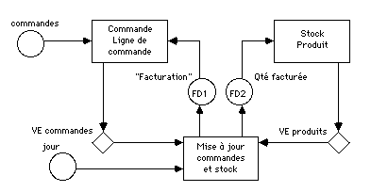
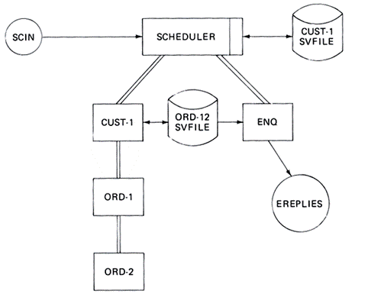
Big-M: Jackson System Development (JSD)
Michael Jackson, 1982
Three-stage process
  Modeling: determines a problem domain's
    entities, with their attributes, and
    the actions they perform, with their attributes, in their time-ordering
  Network: uses a system specification diagram (SSD, above) to model the system as a whole, showing
    processes (rectangles) and
    how they communicate, via
      datastream connections (circles) or
      state vector connections (diamonds)
    with timing constraints (not shown)
  Implementation: uses a system implementation
  diagram (SID, left) to
    show system's virtual processes
    map processes to physical processors
    Individual tasks then realized using JSP

Slide 25
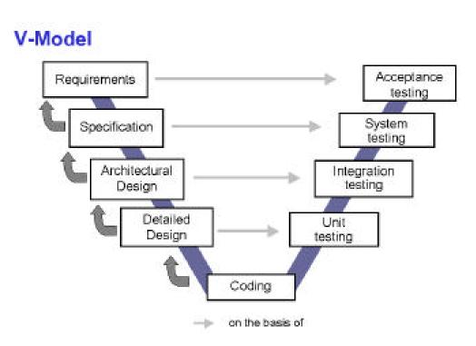
Big-M:
V-Model
Waterfall, with
explicit support for testing
Importance
  called attention to need for different
  kinds of testing during development
  relating testing to artifacts they test
Criticized for oversimplifying development by
  failing to account for iterative nature of design
  ignoring exploratory testing
  postponing any testing until all coding complete

Slide 26
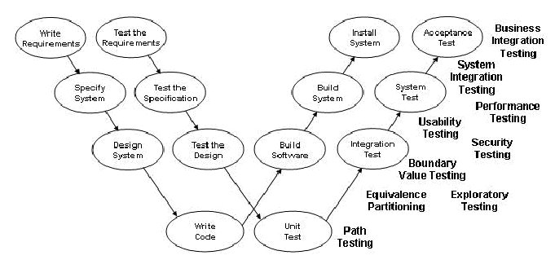
Big-M:
W-Model
Introduced by Paul Herzlich, 1993
V-model refinement that promotes testing throughout development
Includes review-based testing
source: http://wocypunypyzy.wordpress.com/2013/03/15/istqb-exam-online-the-v-model-to-w-model/

Slide 27
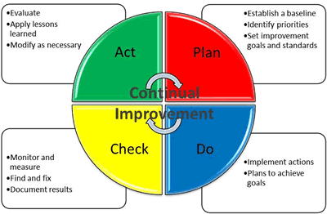
Big-M: Iterative / Incremental
Basis, with enhancements
for current methodologies for
systems (and software) development
More of a meta-metholodogy than a methodology proper
Similar to business process improvement cycle plan-do-check-adjust (a.k.a. plan-do-check-act, PDCA) cycle.
  Popularized by Dr. Edwards Deming, "father" of modern quality control
  Idea: use feedback from actions so far to plan next step towards goals
"Iteration" typically refers to major cycles;
"increment", to cycles within iteration
sources: http://en.wikipedia.org/wiki/Iterative_and_incremental_development

Slide 28
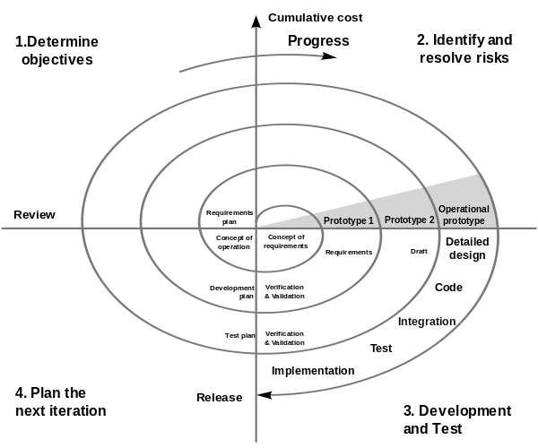
Big-M: Spiral
Barry Boehm, 1986
Focus on risk reduction: i.e.,
  requirements with unresolved,
  high-risk implications
  incomplete, unstable, and/or conflicting
  requirements
  uncertain architecture
  limited time for system development
Four basic activities at each iteration:
  consider win conditions for all success-critical stakeholders
  identify and evaluate alternative approaches for meeting these conditions
  identify and resolve risks stemming from approaches
  obtain approval from all success-critical stakeholders, then proceed
Risk determines degree of detail devoted to non-code artifacts
Process milestones/ points of commitment
  Does current technical and management approach satisfy everyone's win conditions?
  Does current architecture meet all win conditions and adequately address risk?
  Have software, site, users, operators, and maintainers been adequately prepared for a systems launch?
source: http://en.wikipedia.org/wiki/Spiral_model

Slide 29
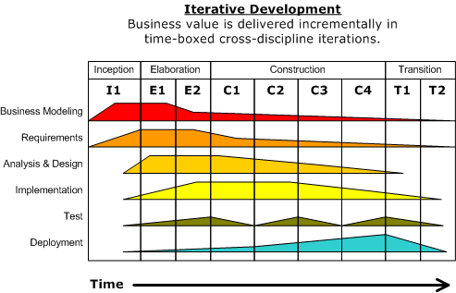
Big-M:
Rational Unified Process
(RUP)
Origins: Rational Software, 1996
Evolving, software-product-based fusion of multiple, earlier methodologies and products for software process management
  Jim Rumbaugh's Object Modeling Technology
  Grady Booch's Booch Method
  UML, business modeling, configuration and change management, performance testing, UI design, real-time development, data engineering,
Acquired by IBM in 2003, which added agile process support in 2006

Slide 30
Big-M: Rational Unified Process (RUP)
Building blocks
  Roles (who) – sets of related skills, competencies and responsibilities.
  Tasks (how) – unit of work assigned to a Role that provides a meaningful result. categorized into nine disciplines:
    six engineering disciplines: business modeling, requirements, analysis and design, implementation, testing, deployment
    three supporting disciplines: configuration, project management,
    tools and process environment
  Work Products (what) – results of Tasks, including documents & models
Process model: within each iteration, four-phase development:
  inception
    scope the system; check plan for stakeholder concurrence, requirements understanding, cost/schedule credibility, architectural depth & breadth, baseline
  elaboration
    mitigate key risks; give architecture basic form; check for stability of vision and architecture; adequate risk resolution and construction plan; stakeholder buy-in
  construction – bulk of the coding
  transition – transition to production

Slide 31
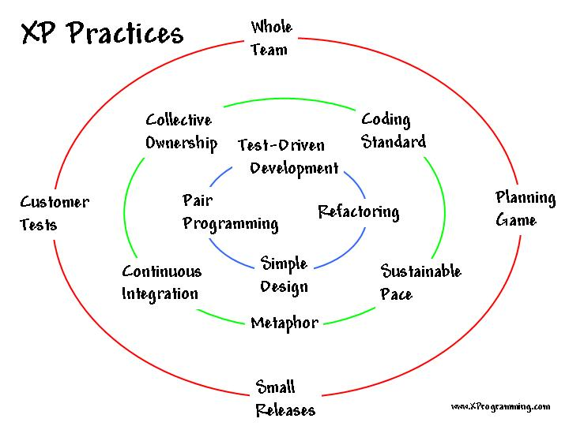
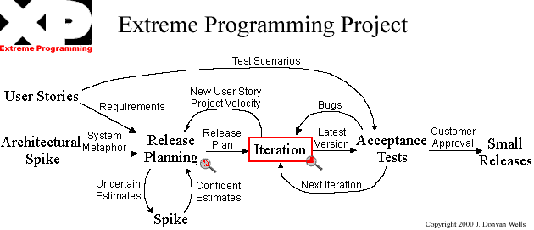
Big-M: XP
Kent Beck, 1996-1999
Blend of classic, KISS-based, coding-and-testing-focused programming practices
  grew out of a coding project for Chrysler
  project was cancelled (!), without delivering software
Selected tenets
  Programmer adoption of appropriate mindset ("virtues")
  Heavy client involvement
  Tests as requirements documents
  Pair programming
  Frequent iterations
  Minimalist implementations
  Acceptance of change throughout development

Slide 32
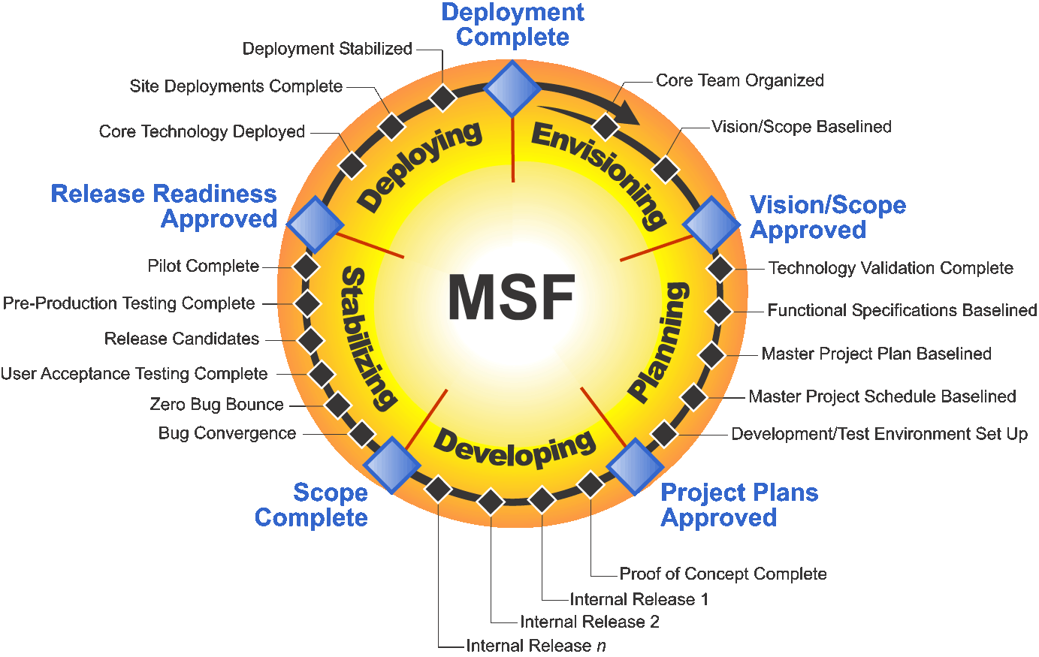
Big-M: Microsoft Solutions Framework (MSF)

Slide 33
Big-M: Microsoft Solutions Framework (MSF)
Principles + mindset + roles + governance + "enactment"
Principles
  Foster open communication
  Work towards a shared vision
  Empower team members
  Establish clear accountability and shared responsibility
  Deliver incremental value, optimizing frequency and value of deliveries
  Expect and adapt to change
  Invest in quality
  Learn from all experiences
  Partner with internal & external customers
Mindset
  Foster teams of peers
  Focus on business value
  Keep the ultimate solution in mind
  Take pride in workmanship
  Learn continuously
  Internalize solution qualities of service
  Practice good citizenship
  Deliver on commitments
Roles
  product management; program management; architect; developer; user experience (UX) analyst; tester; release and operations coordinator
Governance
  balancing efficient and effective use of resources with project constraints
  use of major and interim checkpoints to plan and monitor progress
Enactment
  five overlapping tracks: envisioning, planning, developing, stabilizing, deploying (as per diagram on previous slide)
  iterative development used to deliver value throughout development
  source: http://msdn.microsoft.com/en-us/library/jj161047.aspx

Slide 34
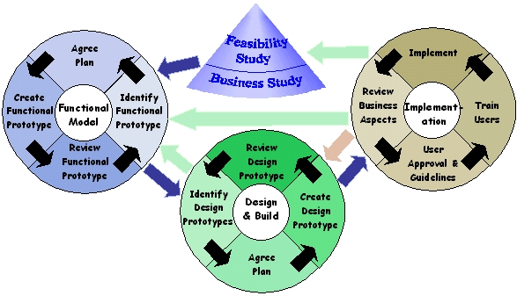
Dynamic Systems Development Method (DSDM)
Original release: 1994
  Goal: disciplined rapid applications development (RAD)
Key features
  Fixes cost, time, quality – treats functionality as variable
  Uses MoSCoW prioritization of scope – musts, shoulds, coulds, won'ts
  Uses eight principles to guide development
    Focus on business needs
    Collaborate – with the right stakeholders, within team
    Never compromise quality
    Build incrementally from firm foundations
    Develop iteratively
    Communicate continuously and clearly
    Demonstrate control – use appropriate formality for tracking
  Uses prescribed roles, assigned at outset of project
    executive sponsor, visionary, ambassador user, advisor user, project manager, technical coordinator, team leader, developer, tester, scribe, facilitator, specialst
    source (and much more): http://en.wikipedia.org/wiki/Dynamic_systems_development_method

Slide 35
Big-M: Component-Based
Goal: leverage component libraries (e.g., .Net, EJB, CORBA, in-house) - and, similarly, platforms (e.g., SAP) for development
Challenge: balancing time savings from components with extra effort of customization
➔ covered in 5300
Big-M: Software Product Line
Goal: develop domain-centered library of software components for rapid development of related products
Example: printer software (HP), controller software…
Challenge: recognizing need in advance
➔ typically requires 2-3 products for breakeven

Slide 36
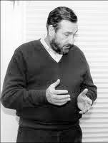
Big-M: Cleanroom Software Engineering
Developed at IBM in 1980's by Harlan Mills et al.
Method as follows:
▪ Model program as set of transformations from inputs to outputs
▪ Develop program incrementally, adding functions over time
▪ Use mathematical methods to verify correctness of each function
▪ Use independent team to do statistical testing on finished logic
Source: Wolak, Chaelynne, "Taking the Art out of Software Development", http://www.scisstudyguides.addr.com/papers/cwdiss725paper1.htm

Slide 37
Big-M: Formal Methods
Typically involve
  use of formal specification languages to define system operation
  use of tools to automatically
    transform those specifications into code
    prove that certain assertions of interest are true for individual specifications - e.g., formalized versions of claims about the specified program's correctness, resistance to tampering, or performance
A subject of research for decades
Currently, practical application largely limited to hardware
➔ covered in more detail in 5200
source: http://en.wikipedia.org/wiki/Formal_methods

Slide 38
Big-M: Additional Categorizations
RAD - rapid applications development
▪ Methodologies that emphasize incremental development with prototyping
▪ Also refers to a specific (RAD) methodology
Agile - "lightweight" applications development
▪ Emphasizes "just in time" planning of development
over extensive pre-planning
▪ Delegates responsibility for planning to programmers
▪ De-emphasizes documentation
Source: http://en.wikipedia.org/wiki/Rapid_application_development

